Slide 1
DEL BIGTREE
Vaccines:
The Perfect Storm of Deception
@HighWireTalk
theHighWire.com

Slide 2
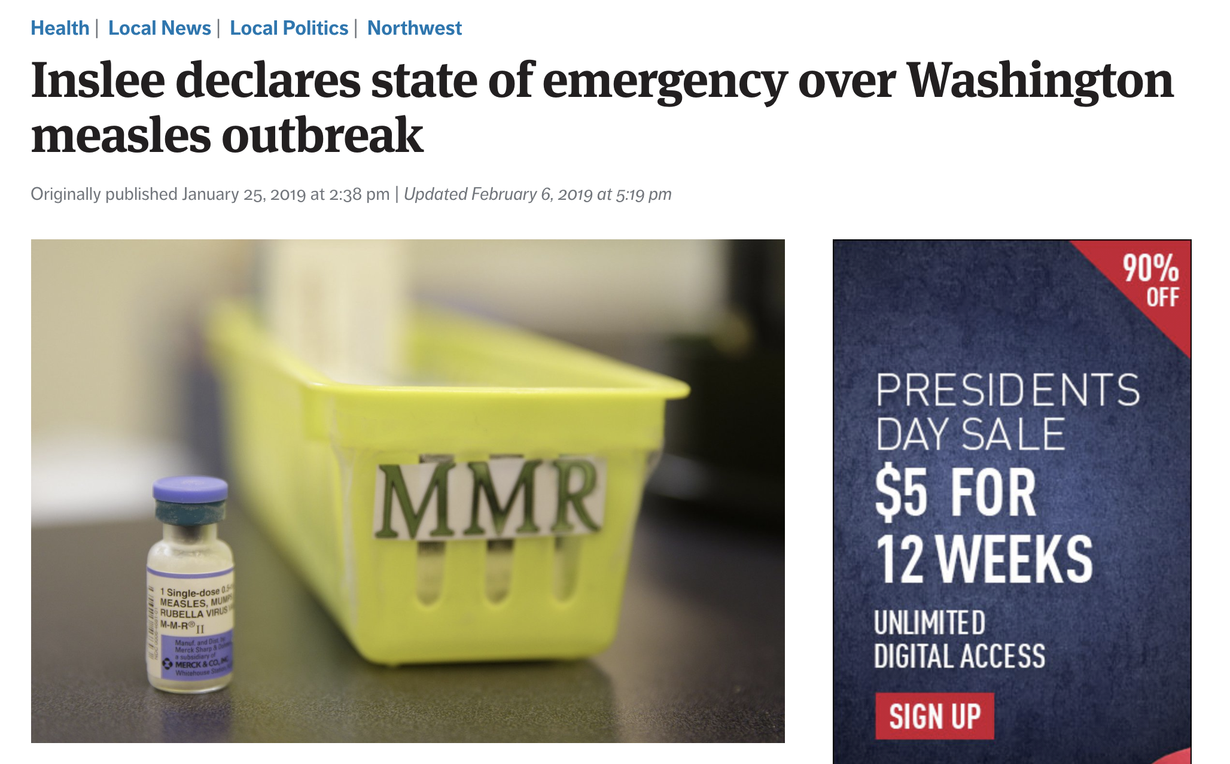

Slide 3
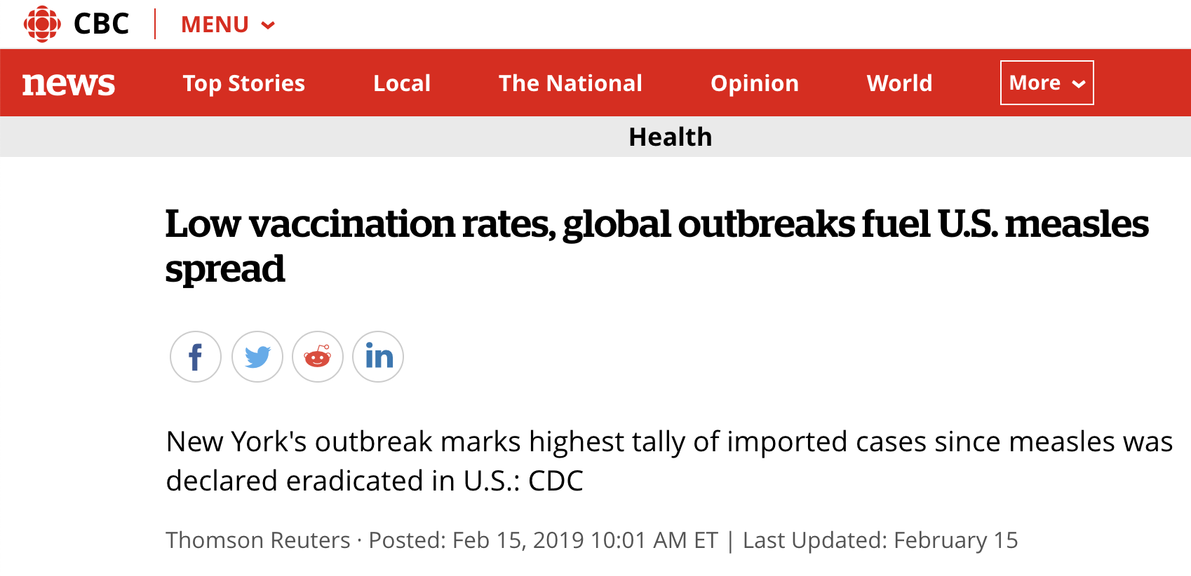

Slide 4
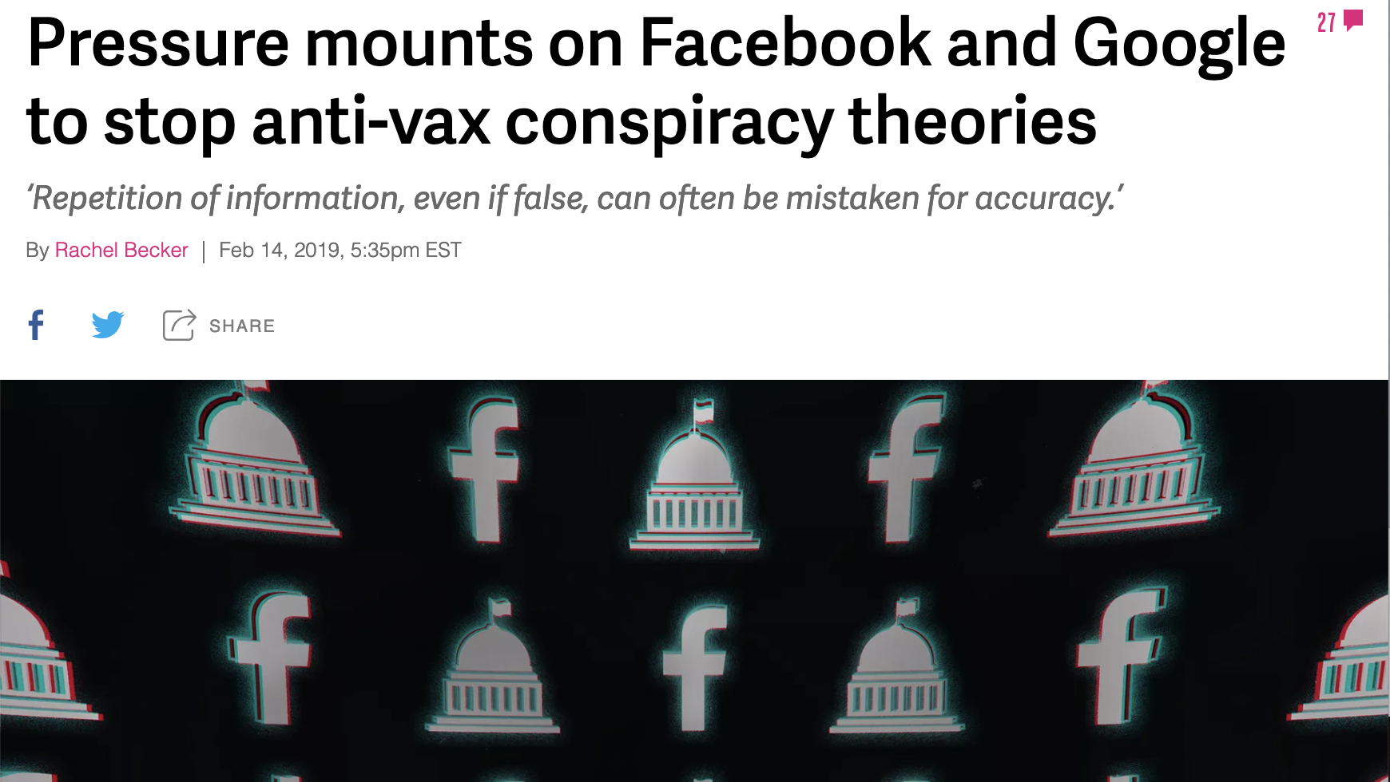

Slide 5
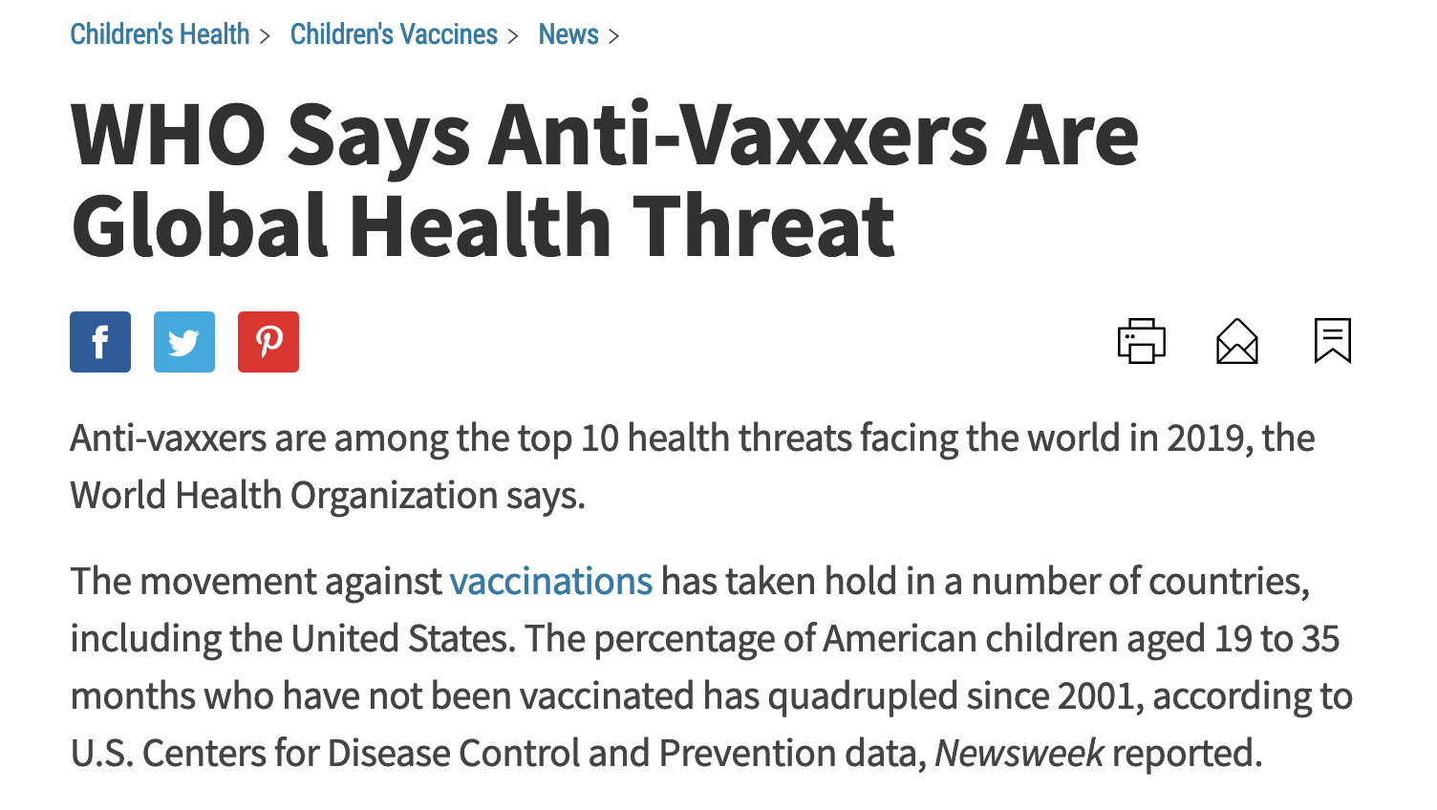

Slide 6
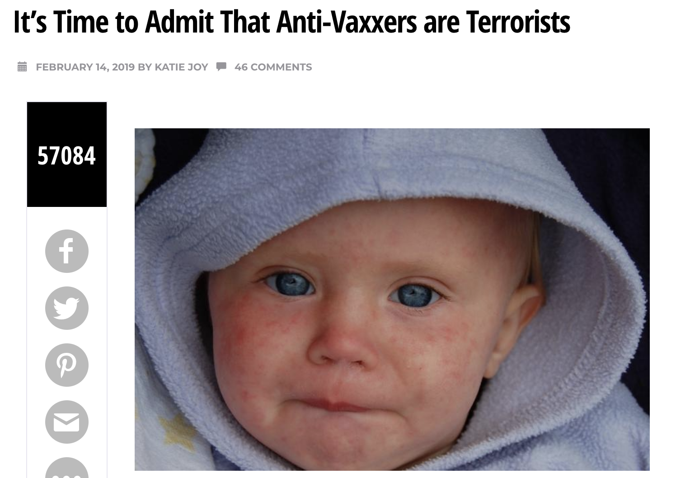

Slide 7
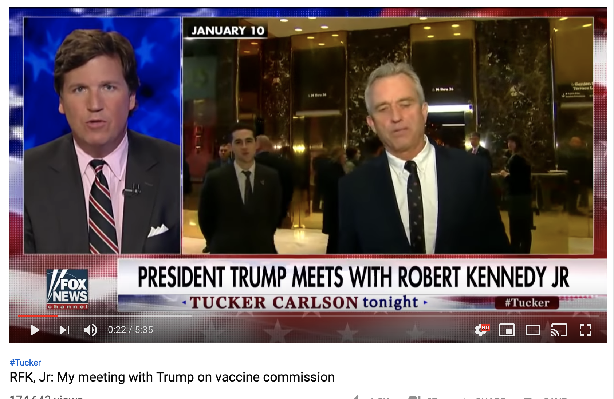

Slide 8
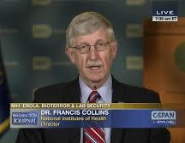
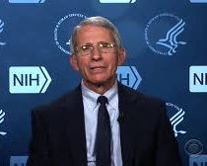
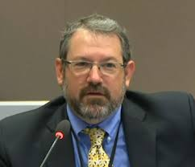
Francis Collins
Anthony Fauci
Joshua Gordon

Slide 9
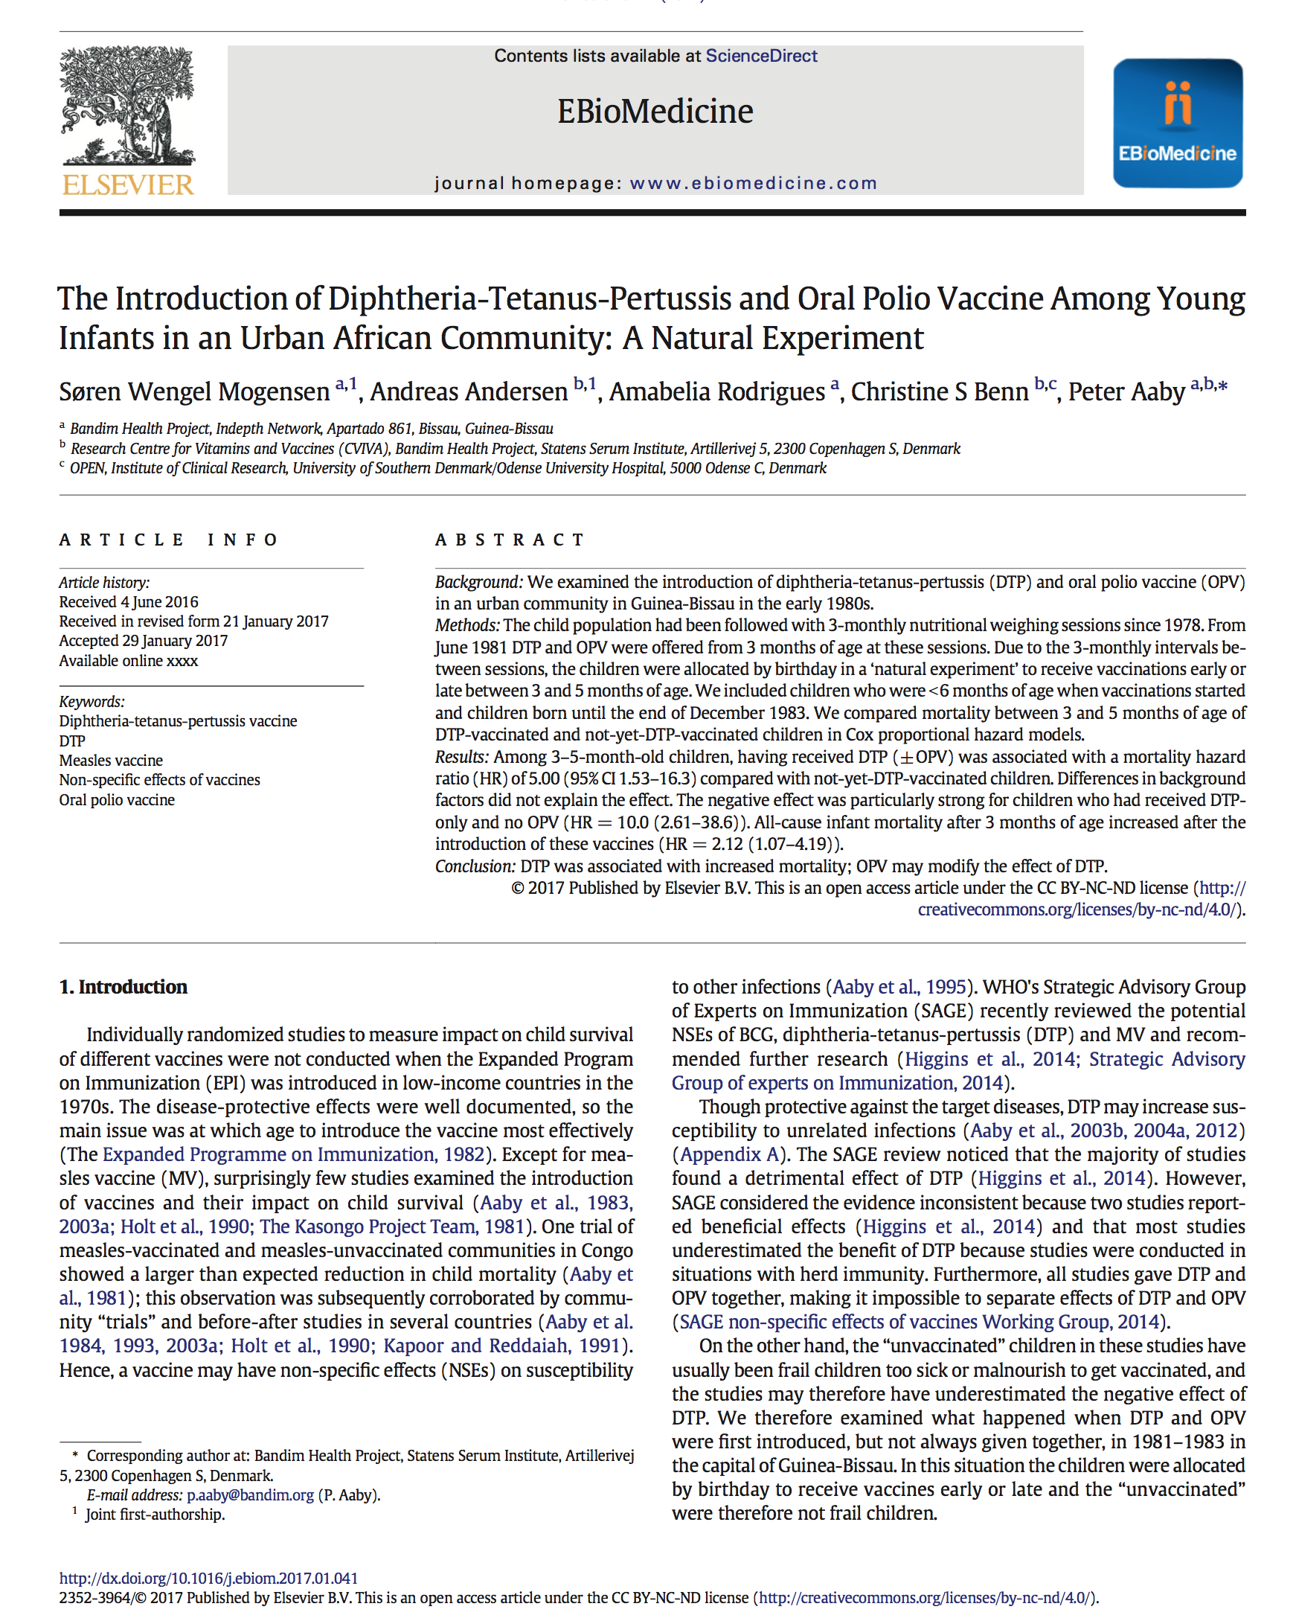
10x

Slide 10
According to the CDC:
1 in 6 children has a developmental disability
*
ADD
ADHD
Autism
Hearing Loss
Learning Disability
Mental Disability
Seizures
Stammering
According to an HHS Funded Publication:
54% of children have chronic illness
†
Anxiety Problems
Asthma
Behavioral Problems
Bone and Muscle Disorders
Chronic Ear Infections
Depression
Diabetes
Digestive Allergies
Environmental Allergies
Epilepsy
Rheumatoid Arthritis
Seizure Disorder
*Source: https://www.cdc.gov/ncbddd/developmentaldisabilities/about.html
†Bethel et. al, 2011, A National and State Profile of Leading Health Problems and Health Care Quality for US Children: Key Insurance Disparities and Across-State Variations, Academic Pediatrics.

Slide 11
Number of Childhood Vaccine
Injections Administered
Childhood Chronic Illness &
Developmental Disability Prevalence
11
53
12.8%
†
*
54%
1986 schedule
2017 schedule
1986 prevalence
2011 prevalence
* Cleave et. al, 2010, Dynamics of Obesity and Chronic Health Conditions Among Children and Youth, JAMA.
†Bethel et. al, 2011, A National and State Profile of Leading Health Problems and Health Care Quality for US Children: Key Insurance Disparities and Across-State Variations, Academic Pediatrics.

Slide 12
The Perfect Storm
#1 - NO LIABILITY
#1 - NO LIABILITY

Slide 13
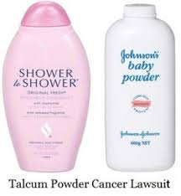
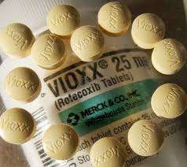
PHARMA PAYS BILLIONS IN LAWSUITS
PHARMA PAYS BILLIONS IN LAWSUITS

Slide 14
8
National Childhood Vaccine Injury Act
The 1986 Act
Immunity from Liability

Slide 15
The Perfect Storm
1 - NO LIABILITY
1 - NO LIABILITY
2 - NO SAFETY STUDIES
2 - NO SAFETY STUDIES

Slide 16
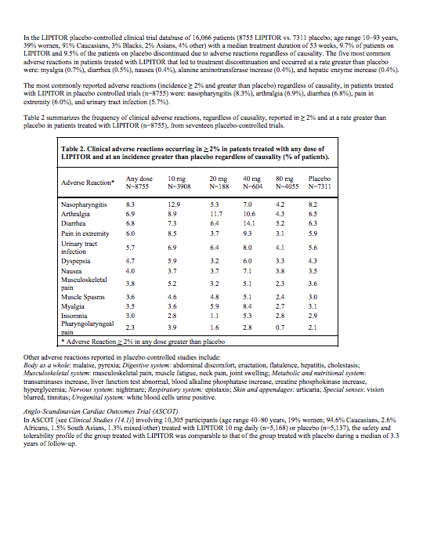
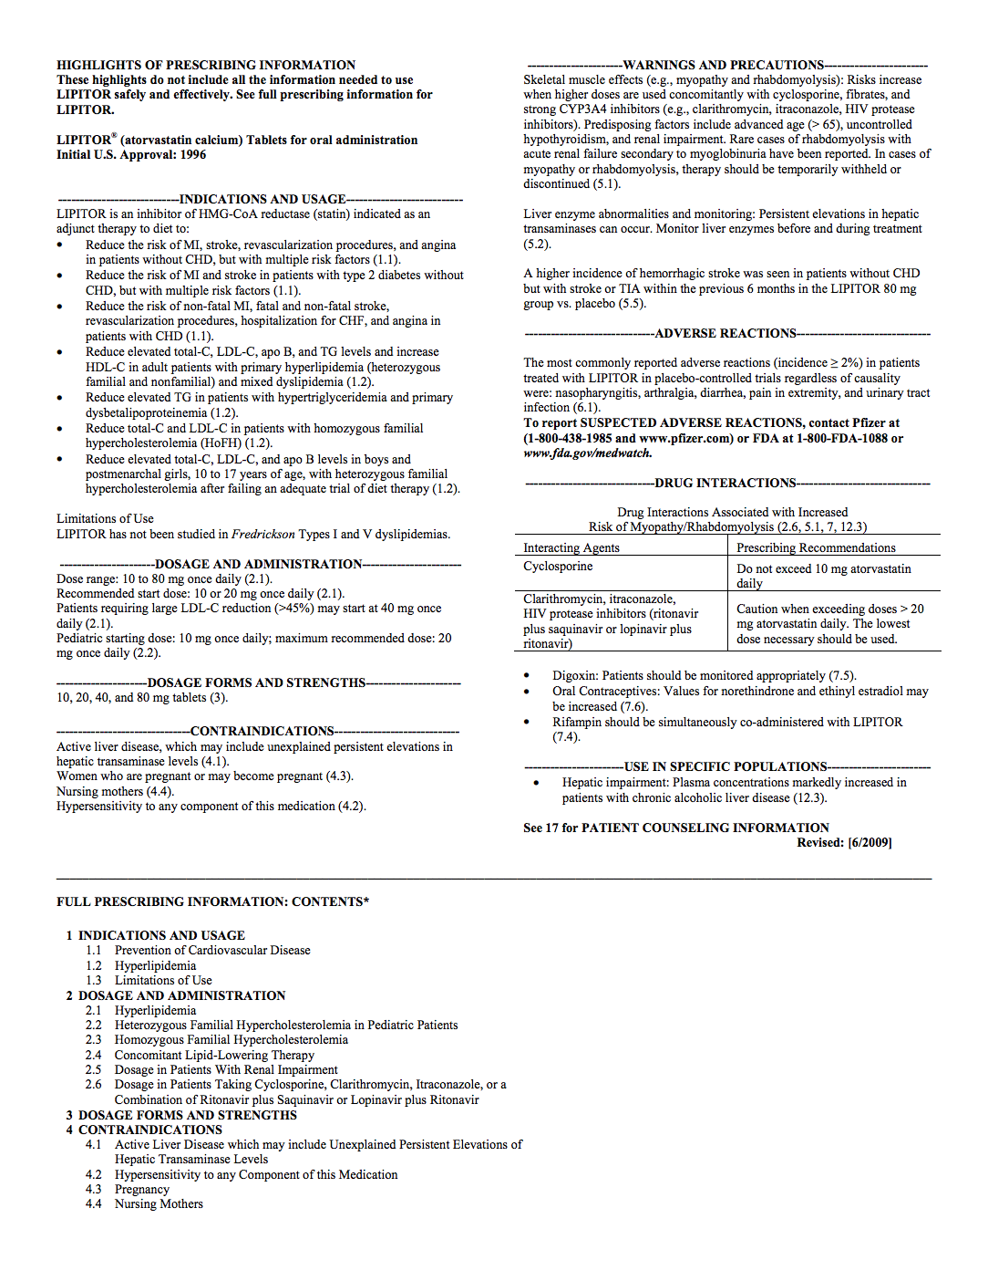
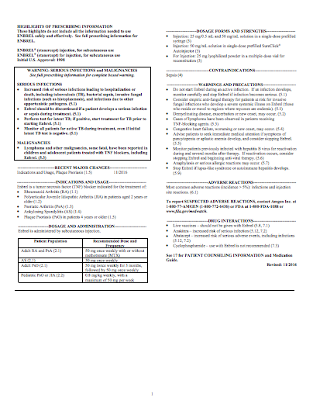
How Vaccines are Licensed, Recommended, Promoted, Defended
Product | Safety Review Period Prior to Licensure | Placebo Group
Enbrel | 6.6 Years | Saline Injection

Slide 19
How Vaccines are Licensed, Recommended, Promoted, Defended
Recommended Age (First Dose) | Vaccine/ Manufacturer | Safety Review Period Prior to Licensure | Subject Group | Placebo Group
1 Day Old | Hep-B (Engerix)/ GlaxoSmithKline | 4 Days | Hep-B | No Placebo
1 Day Old | Hep-B (Recombivax)/ Merck | 5 Days | Hep-B | No Placebo
2 Month Old | Polio (PVI- Monkey Kidney)/ Sanofi Pasteur | 48 hours | Polio + DTP | DTP

Slide 21
The Perfect Storm
1 - NO LIABILITY
1 - NO LIABILITY
2 - NO SAFETY STUDIES
2 - NO SAFETY STUDIES
3 - NO CHOICE
3 - NO CHOICE

Slide 22
Advisory Committee On Immunization Practices
Advisory Committee On Immunization Practices
2000 - Investigation Into ACIP by U.S. Government Reform Committee:
“The CDC grants blanket waivers to the ACIP members each year that allow them to deliberate on any subject, regardless of their conflicts, for the entire year.”
ACIP reflects “a system where government officials make crucial decisions affecting American children without the advice and consent of the governed.”

Slide 23
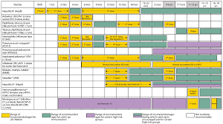
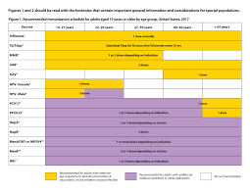
CDC Childhood Vaccine Schedule
CDC Childhood Vaccine Schedule
CDC Adult Vaccine Schedule
CDC Adult Vaccine Schedule

Slide 26
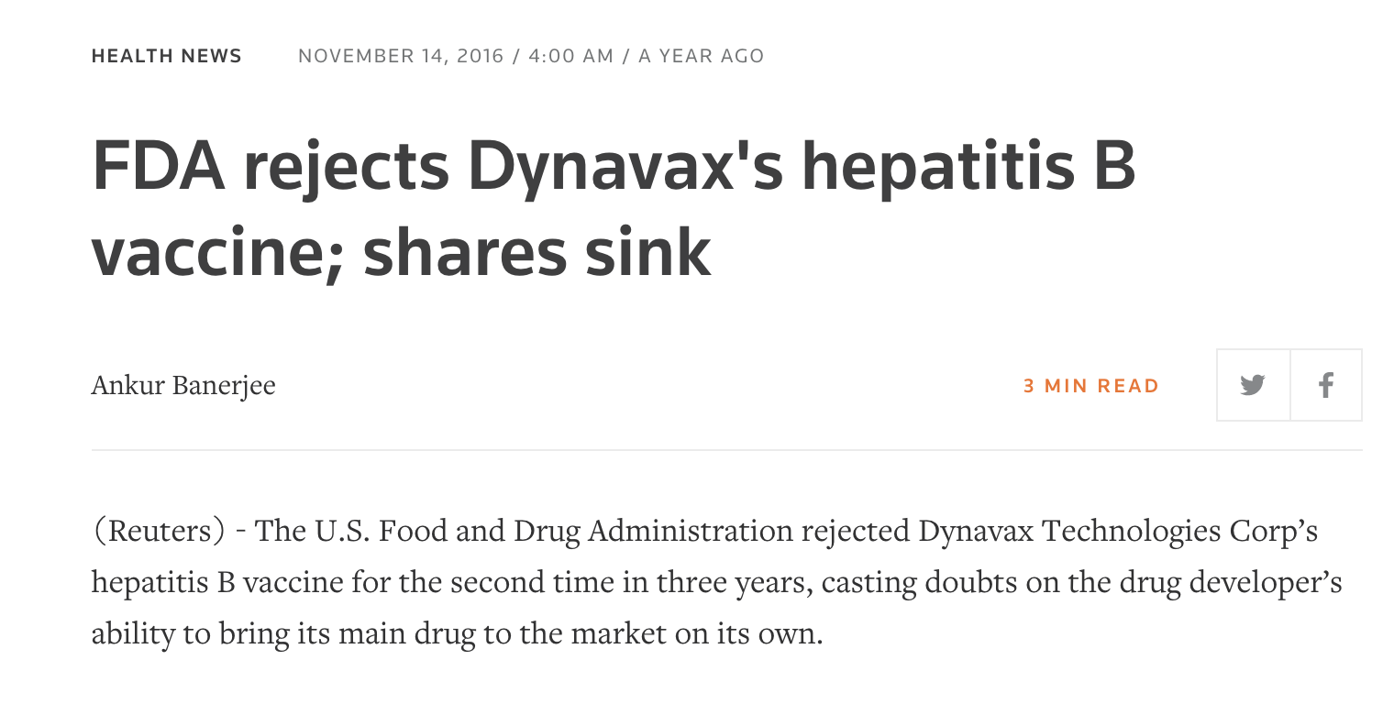

Slide 27
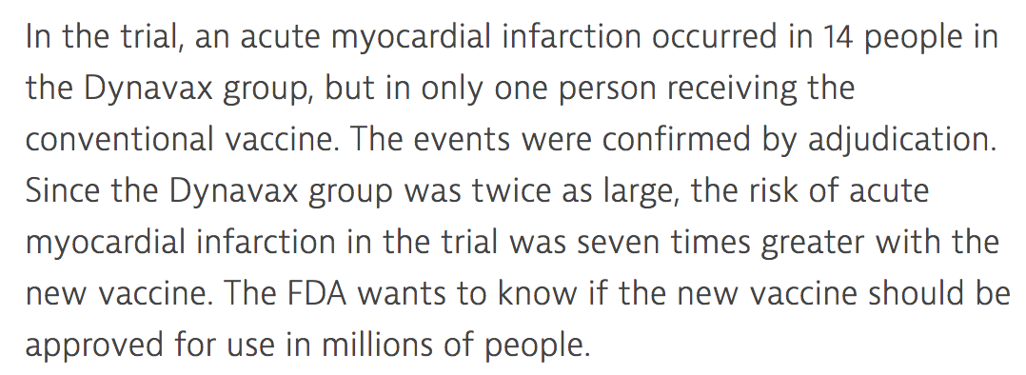

Slide 29
For More Information
TEXT: 33 222
MESSAGE: ICAN
WATCH
The HighWire w/Del Bigtree
Thursdays 11am PST

